Slide 1


C bhavya sree
Diwakar Pratap
Kusuma K M
Ravi Kumar m r
Vs praneeth

Slide 2
C O N T E N T S
Background of Movie Adda
Problem Statement & Proposed System
Goals
Users
Database Design & UML Diagrams
Implementation
Conclusion
Requirements
Testing
Technologies Used

Slide 3
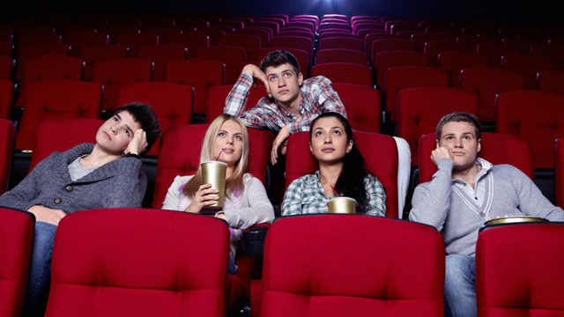

Background of MOVIE ADDA
Unites Movie lovers
Reduced Time
Accessible Anywhere Anytime

Slide 4
Goals
To book tickets online at anytime from anywhere
To select desired seats
To select desired theatre
Can book any number of tickets
To manage movie details
To build an application that reduces the manual work for managing the movie, ticket, booking, customer.

Slide 5
Problem Statement
Long waiting Hours
Queue
Limited Number of Ticket Bookings

Slide 6
Proposed System
Movie Details
Reduces Time
Easy & Secure Payment

Slide 7
Users
Customers
Theatre Owners

Slide 8
Requirements
Functional Requirements:
User Requirement :
Registration
Login
Seat Viewing
Payment
Logout
View Movies
Generate Tickets
Monitor that customer fills all mandatory fields
Select Theatre

Slide 9
Requirements
Theatre Owner Requirements:
Register Theatre
Add/Edit Theatre
Admin Requirements:
Add, Update, Delete Movies
View Movies
View Theatres
View Collection

Slide 10
Requirements
Non – Functional Requirements:
User is guided to fill all the mandatory fields
Security
Accessibility
Availability
Portability

Slide 11
Database Design
USER TABLE
User_ID
User_Name
Gender
Mail
DOB
Place
Password
Mobile_No
THEATRE TABLE
Theatre_ID
Theatre_Name
Owner_Name
Place
Timings
Food
Number_of_Screens
Password

Slide 12
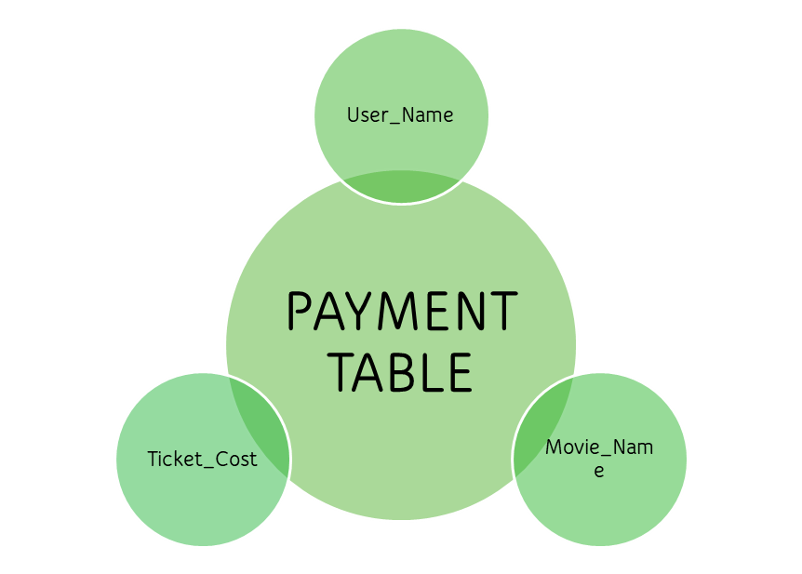
Database Design
MOVIE TABLE
Movie_Name
Duration
Release_Date
Languages_Available
Genre
Images
Theatre_Name
Ratings
Ticket_Cost
Trailer
Description

Slide 13
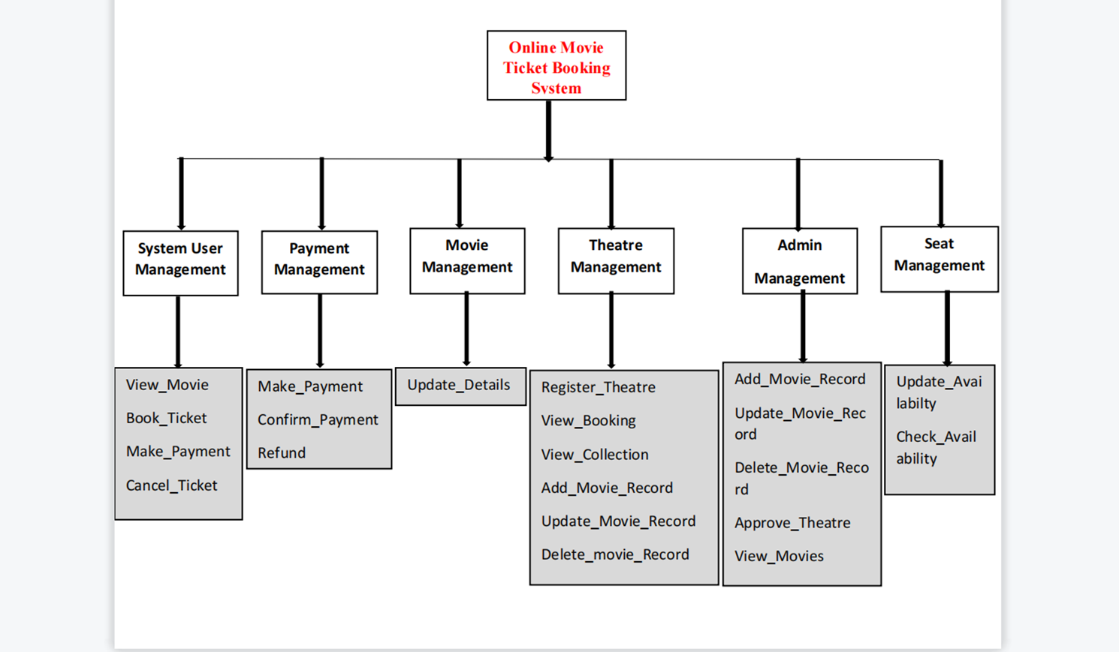
Architecture Diagram

Slide 14
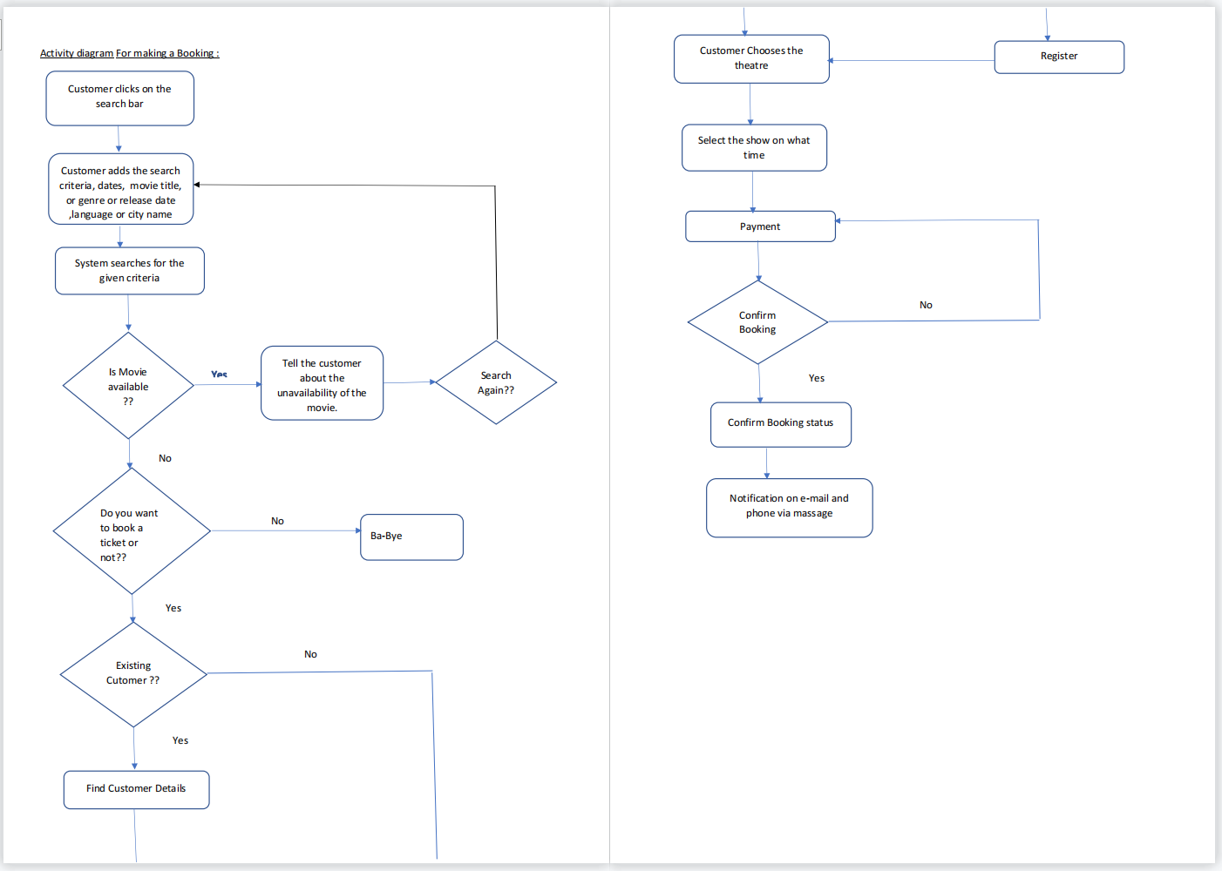
Activity Diagram

Slide 15
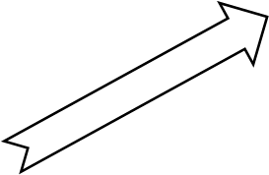
Class Diagram
Movies
Update_Details()
User
Login()
Logout()
View_Movies()
Book_Ticket()
Make_Payment()
UPDATE
Admin
Add_Movies
Update_Movies
Delete_Movies
Make Payment
Theatre
Add_Movies()
Register()
View_Bookings()
Update_Movies()
Delete_Movies()
Payment
Confirm_Transaction()
Make_Payment()
Confirm Registration

Slide 16
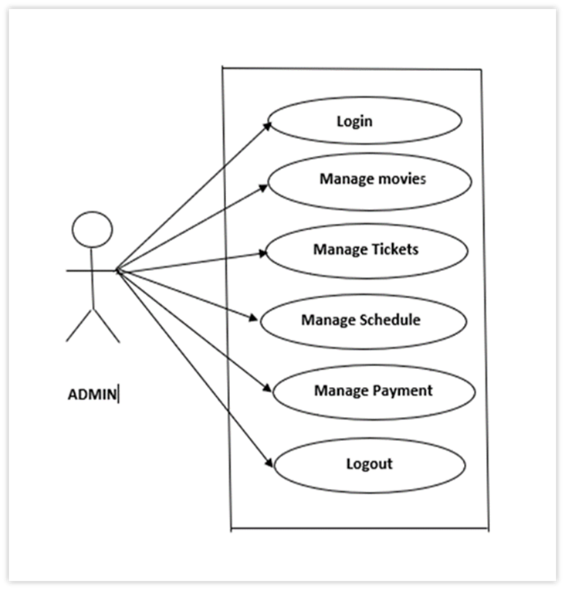
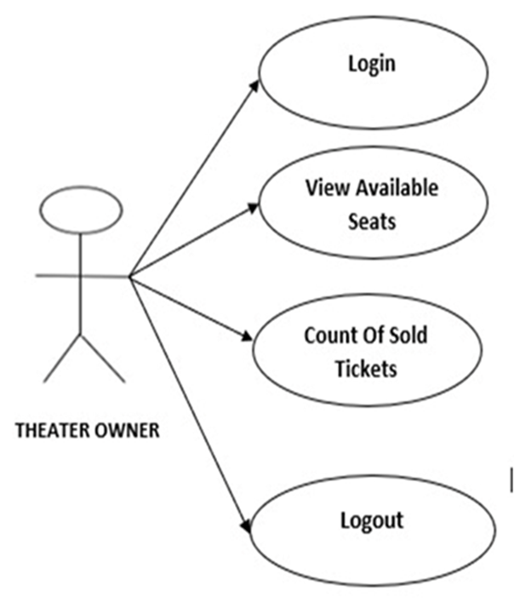
Use – Case Diagram

Slide 17
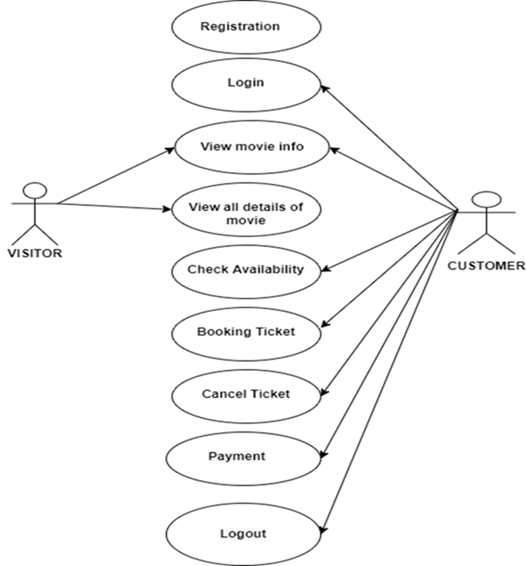
Use – Case Diagram

Slide 18
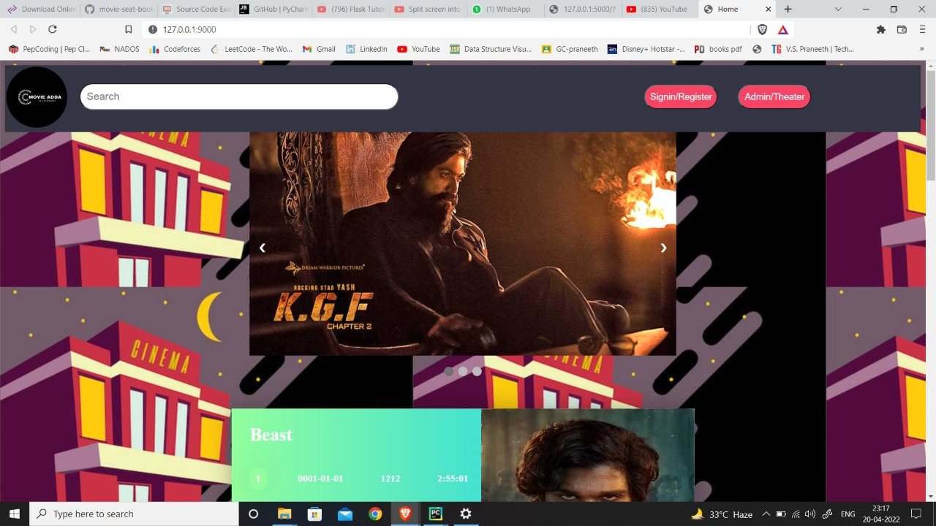
Implementation
LOGIN MODULE

Slide 19
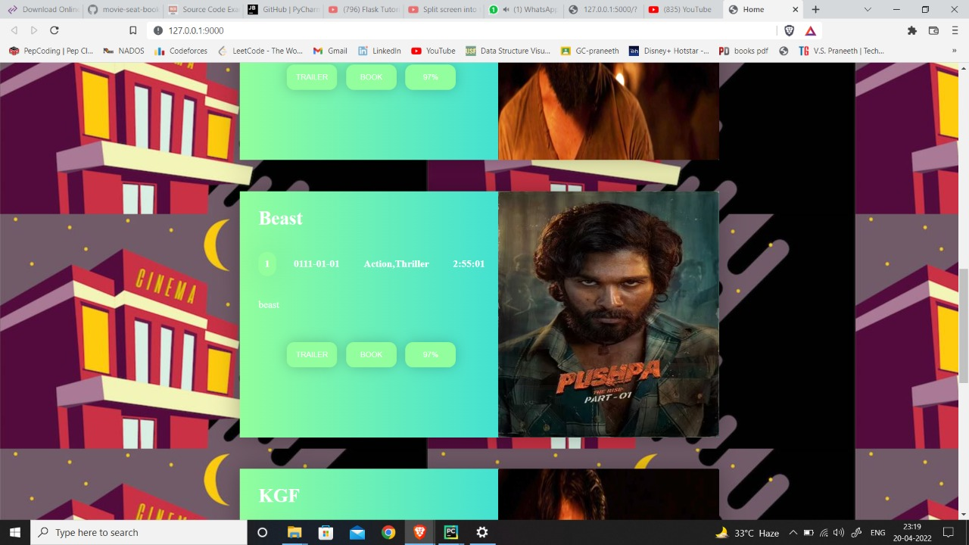
Logged – In Module

Slide 20
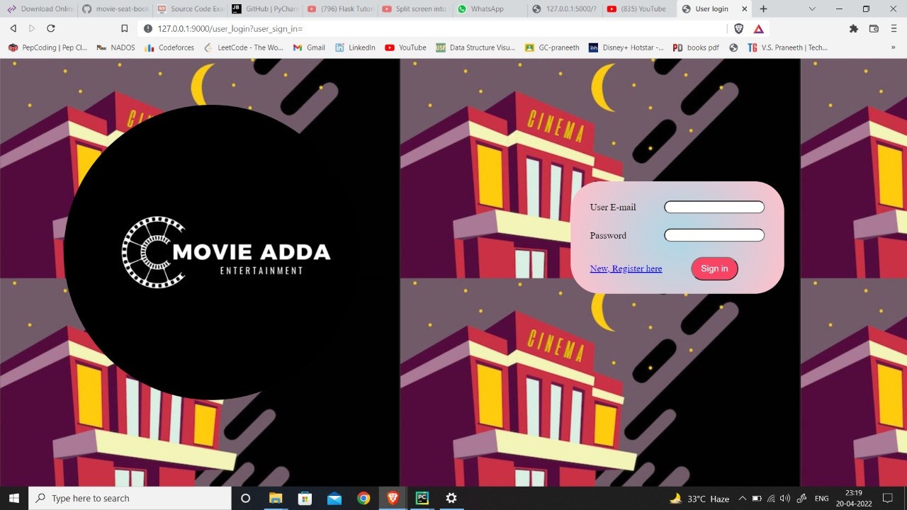
User Sign-In Module

Slide 21
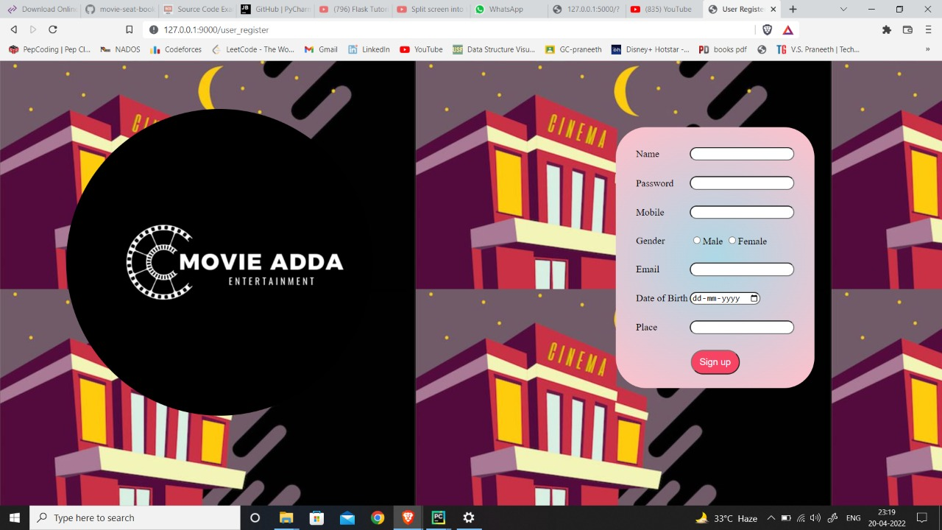
New User Registration Module

Slide 22
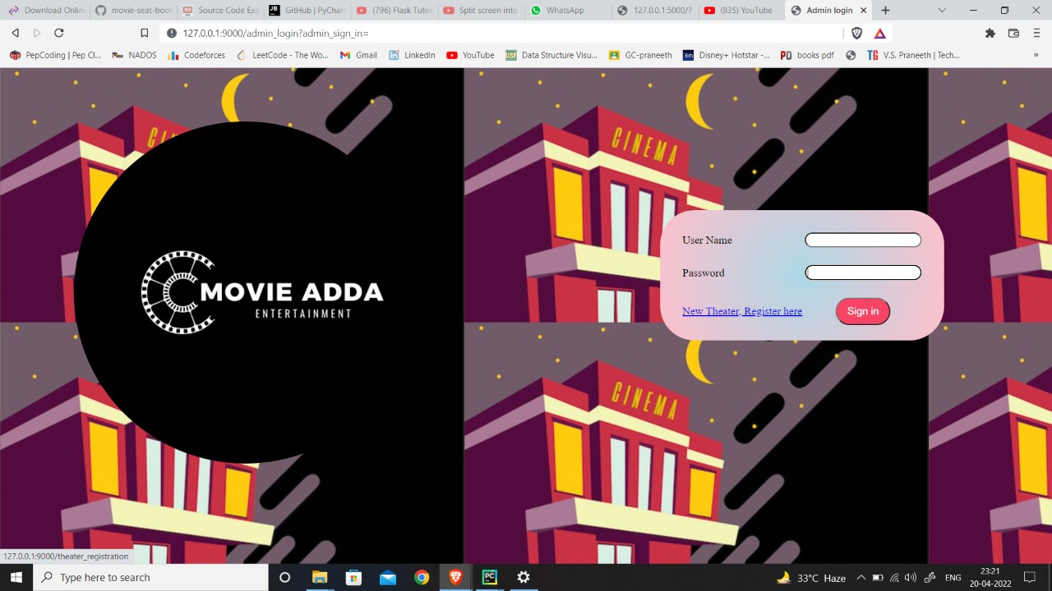
Admin & Theatre Owner Sign – In Module

Slide 23
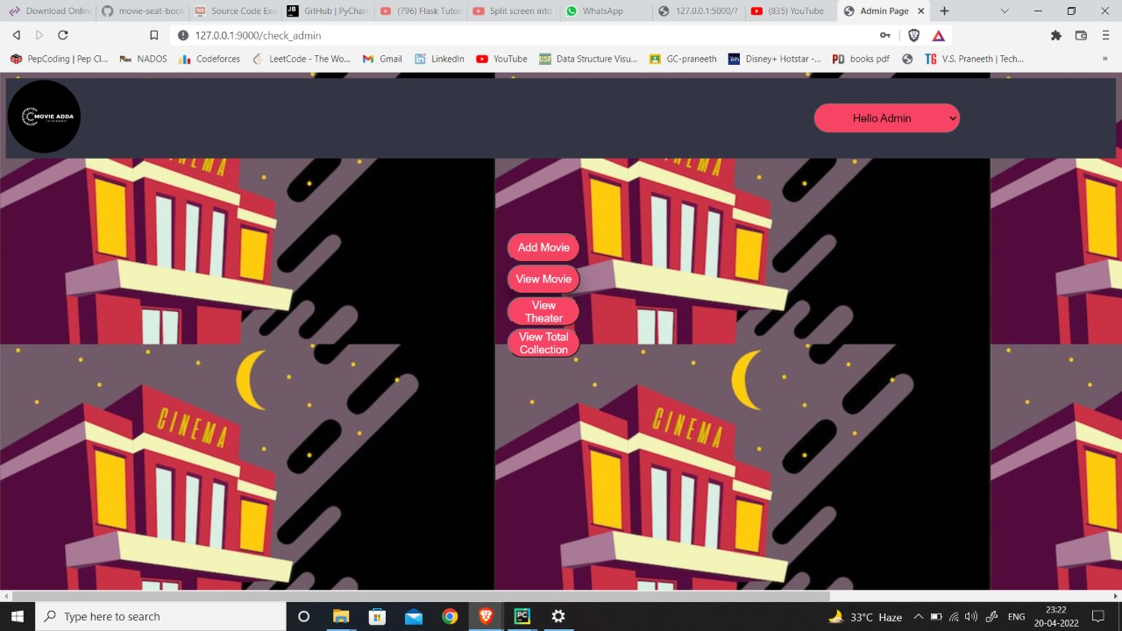
Admin Module

Slide 24
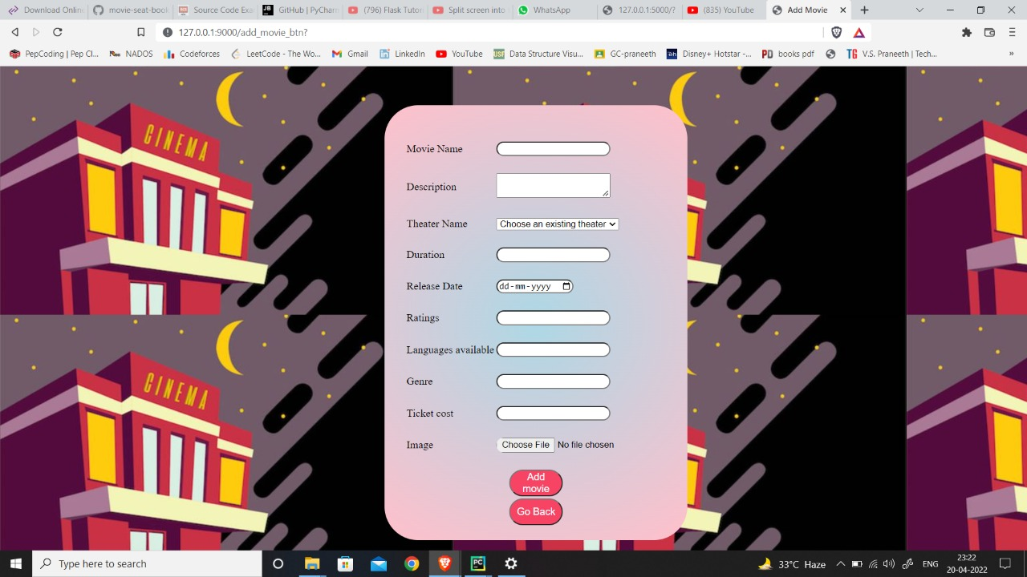
Add Movie Module

Slide 25
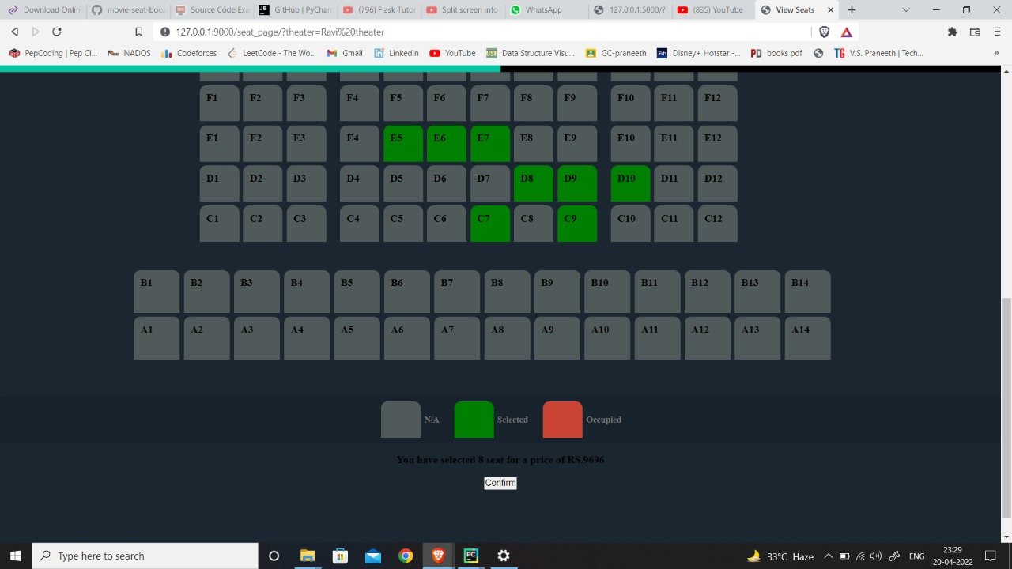
Seat Selection Module

Slide 26
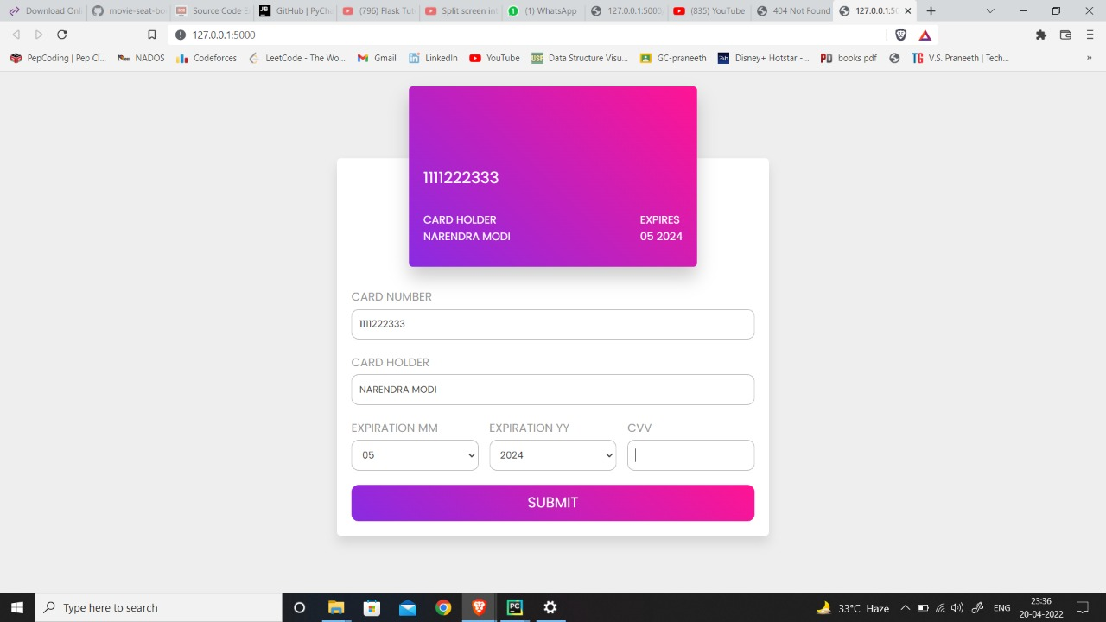
Payment Module

Slide 27
Testing
View Collection
Home Page
Admin Login
View Theatre
User Sign-in

Slide 28
Technologies Used
Front End
HTML
JavaScript
Back End
Python
RobotFramework
Database
SQLite3
CSS
Flask
Selenium

Slide 29
Conclusion
1
An online ticket booking system is developed where the customers can book a ticket for the food and avoid long waiting hours in a queue.
2
Using the application, the end users register online, book tickets for a particular movie in a theatre of their choice.
3
Customers can book any number of tickets they wish.
4
Local theatre owners can also register, view collections.

Slide 30


